Slide 1

Cat Burglar
Game Dev Sim

Slide 2

Table Of Contents
Game Concept 3
Artists & Roles 4
Artist Contributions 5
Jayden 5
Liam 17
Moodboard 22
Project Asset List 23
Roles 24
Platform Considerations 25
Tool Inventory 26
Art Specifications 27

Slide 3
Game Concept
Cat Burglar will be set in home environments which will be accomplished by creating assets and models with a stylised approach. As it will be top down, we plan to make the inner walls of the levels transparent so the player can see where they are leading their character.

Slide 4

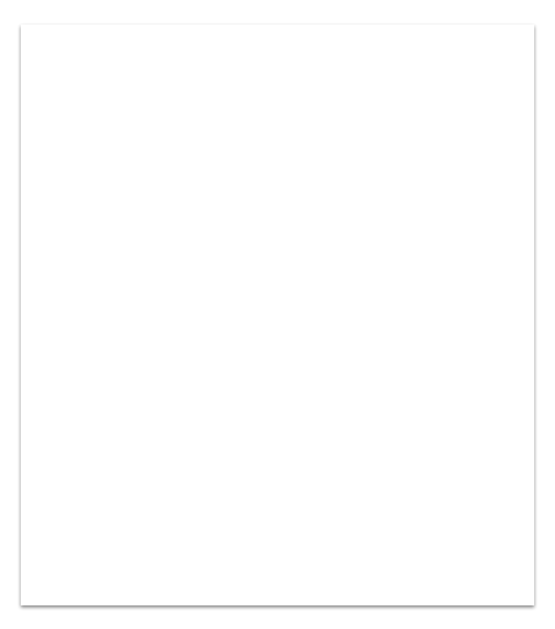
Artists & Roles
Jayden:
Will be doing character rigging and animation, creating x1 player character, creating dog model and contributing to environmental asset production.
Liam:
Will be modelling and texturing the items, furniture and various background pieces.

Slide 5
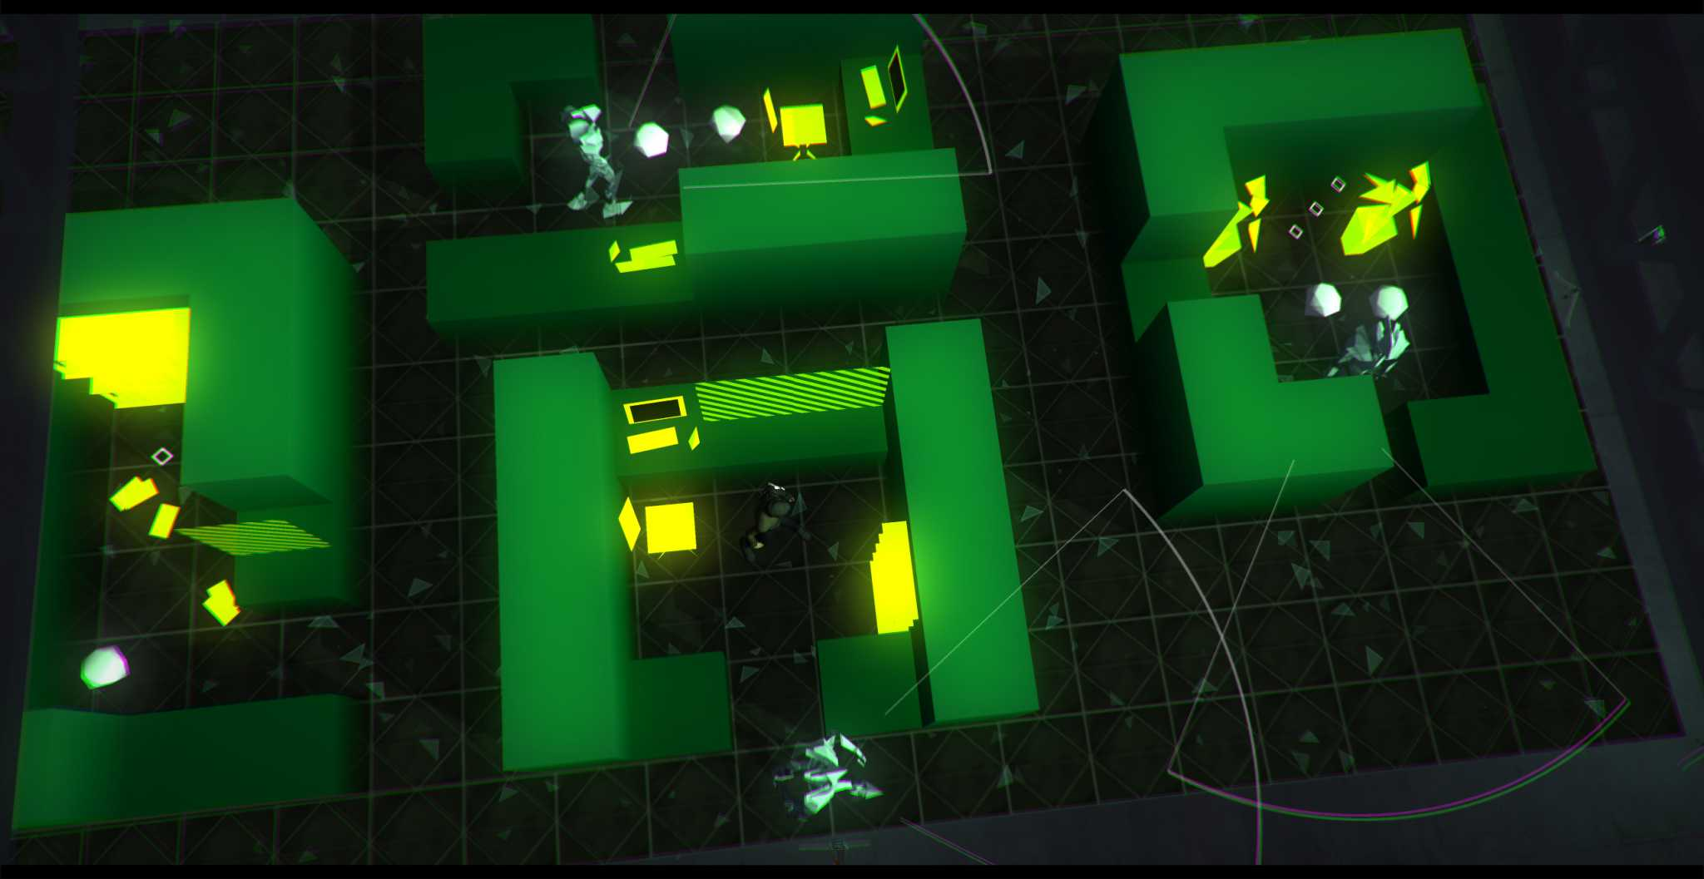
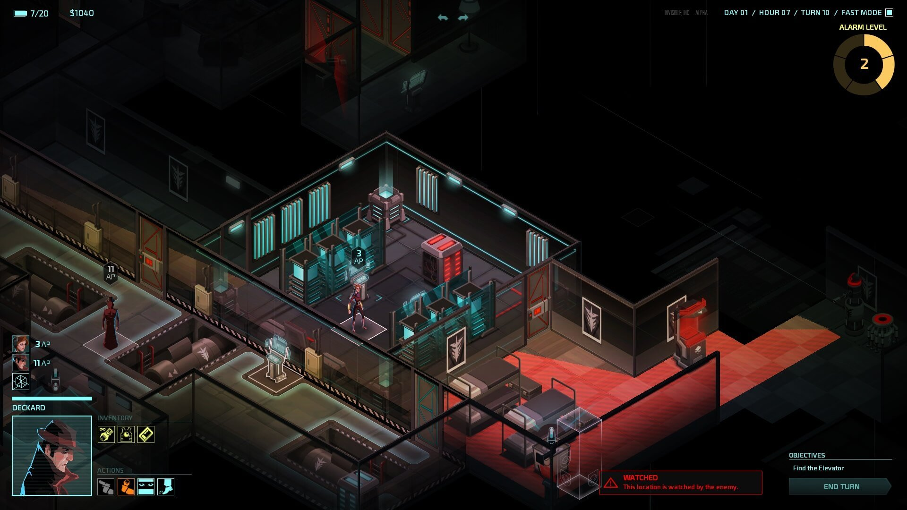
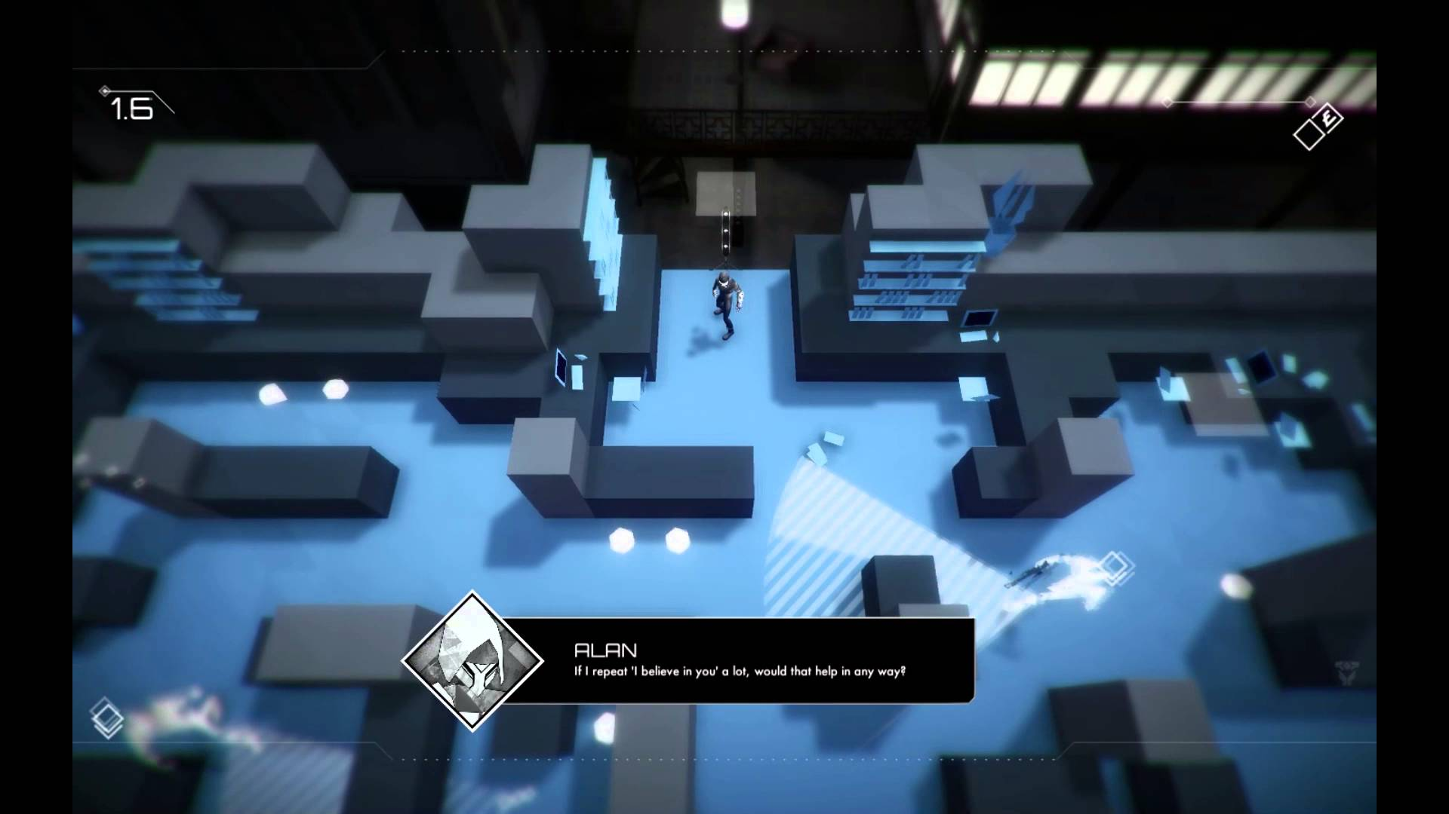
Artist Contributions Reference: Environment
Jayden
Simple almost primitive shapes act as walls, relies on chromatic aberration, bloom, depth of field and an appealing UI to pull off simple art style. (Game is Volume)
Transparent inner walls so player can see the interior of the environment while outer walls are opaque. Colour palette of Invisible Inc. is high contrast consisting of dull and dark colours and bright, almost neon colours. It also has an appealing UI.
This is also Volume but on a different map. Different colours to differentiate between different levels would be easy for both artists to pull off as it only requires creating modular assets and little texturing.

Slide 6
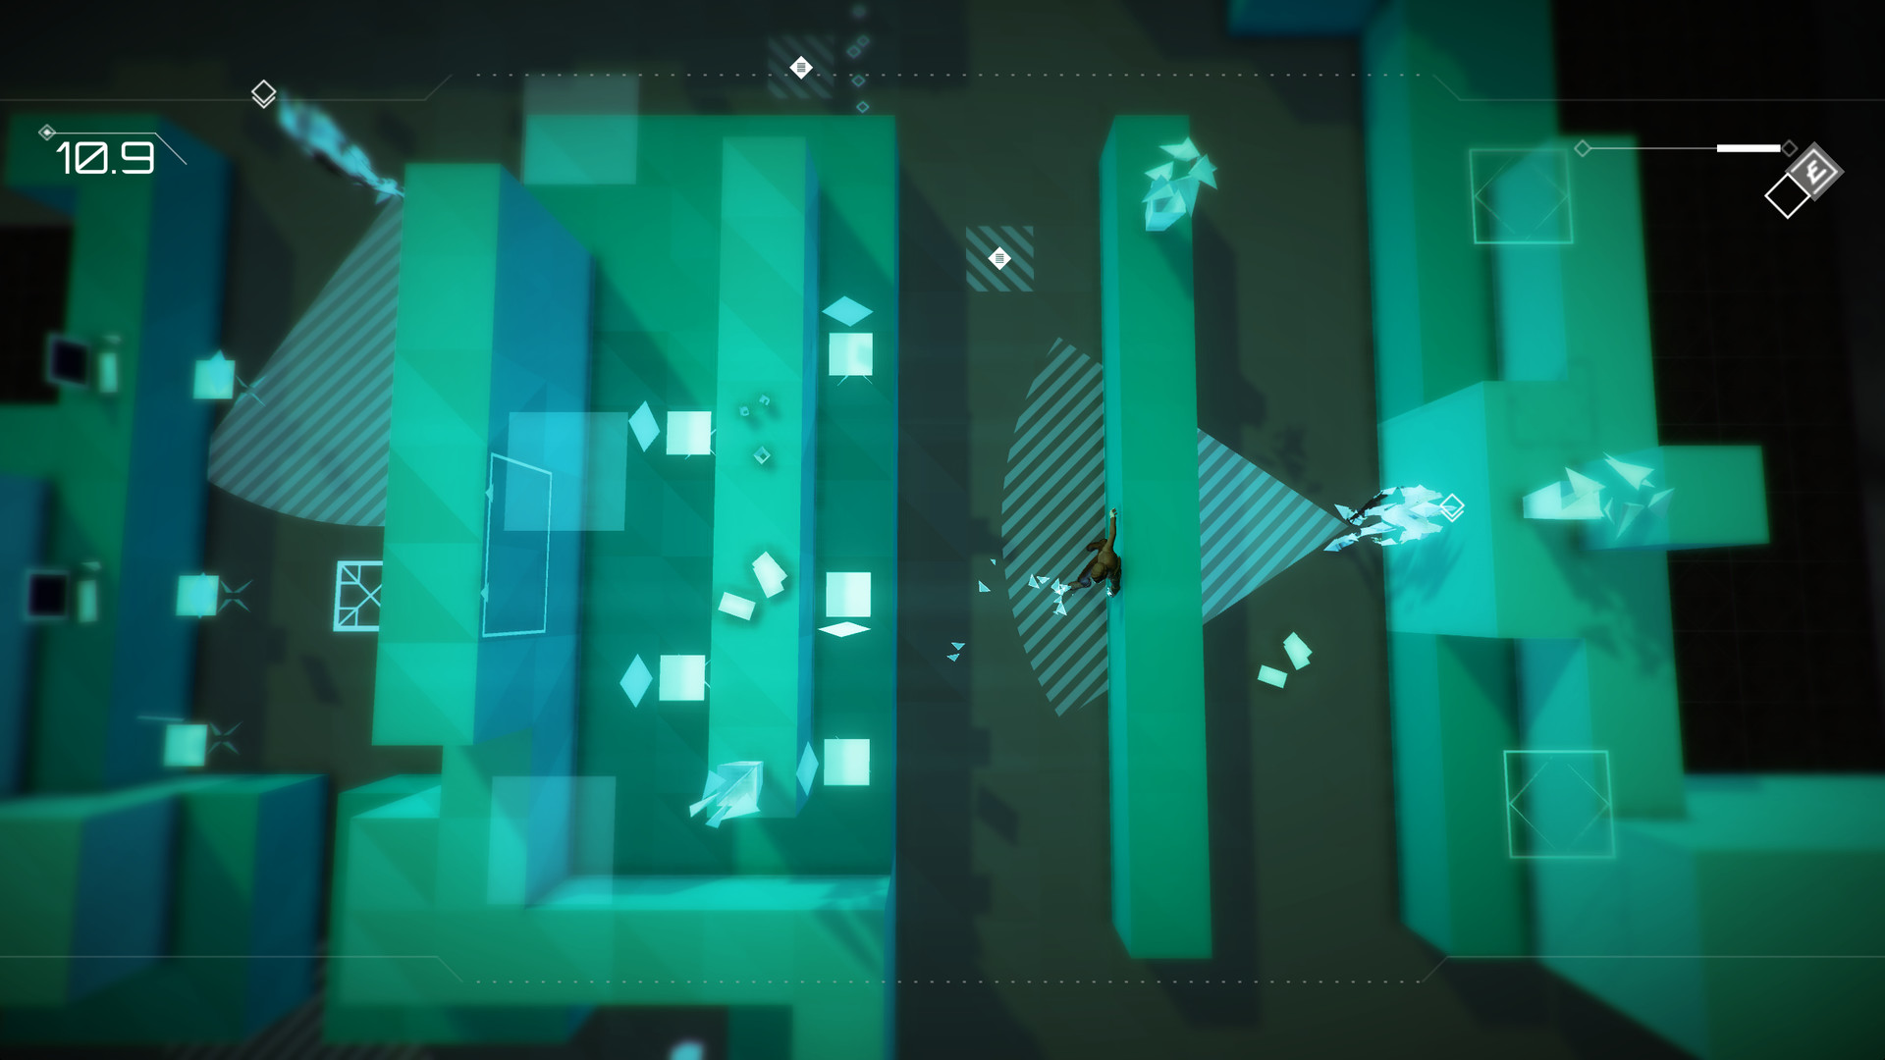
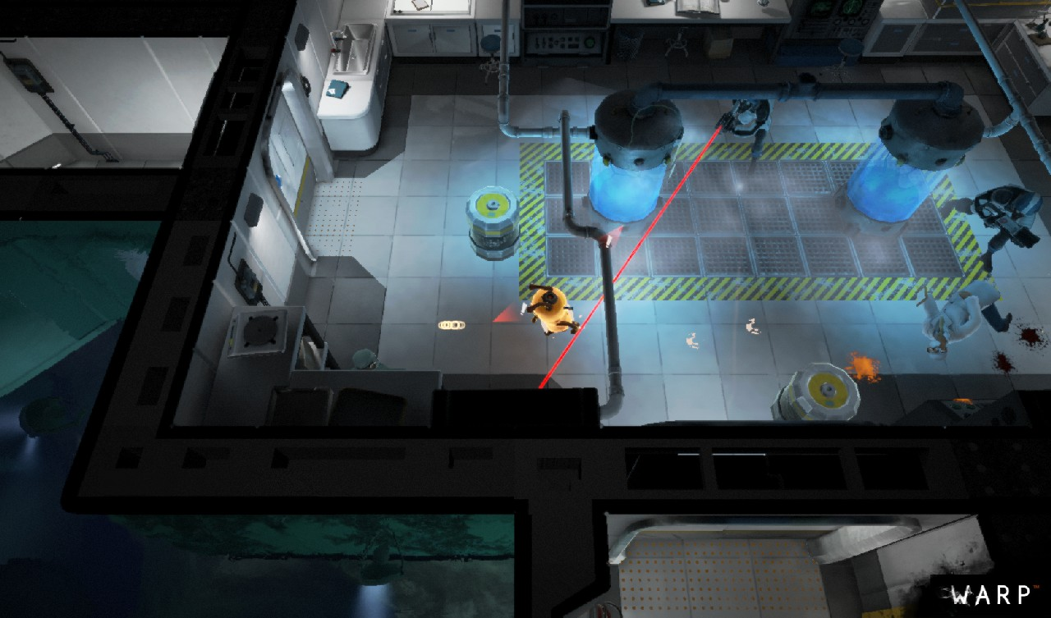
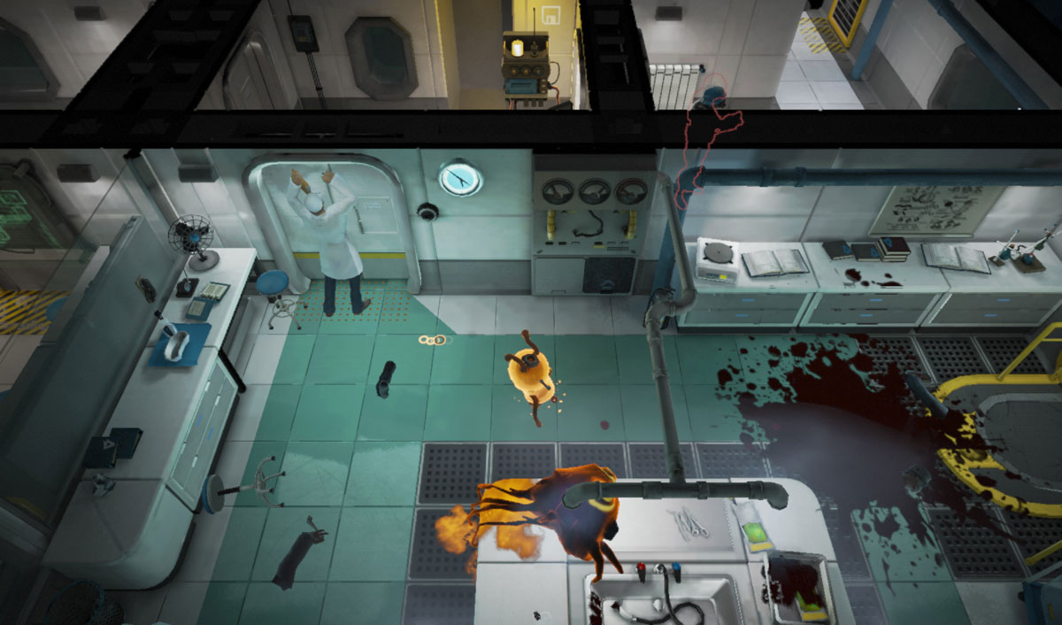
Artist Contributions Reference: Environment
Jayden
The walls in Volume are brightly coloured so the player has a clear view of the layout and where they need to be going. Important objects are also highlighted in white. The colour palette is responsible for leading the player as the walls and map layout are simple.
Warp has a lot of assets that are reused in within the map. The map layout and way we want to create our map is kind of similar as well as it’s super modular. The art style is also a good choice of reference if we don’t want to go with the simpler style Volume has. The exterior of the map is also a good touch, we could repurpose the exterior environment to show the day/night cycle mechanic we have by having the outside become brighter as time goes on.

Slide 7
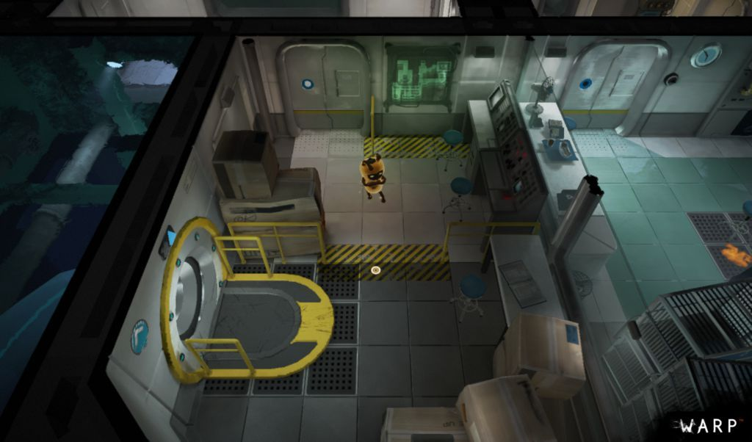
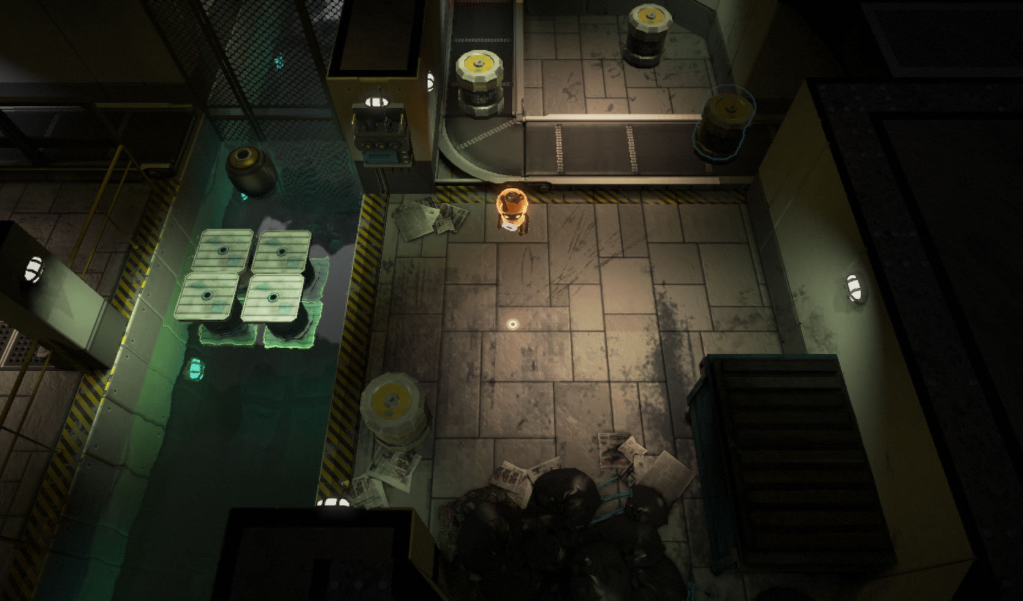
Artist Contributions Elected Art Style
Jayden
Warp’s art style was preferred by the team, and as the scope is to make one level it will be achievable. We will be creating the level with a stylised art style done in Substance Painter. We can add different elements from the other referenced games.

Slide 8
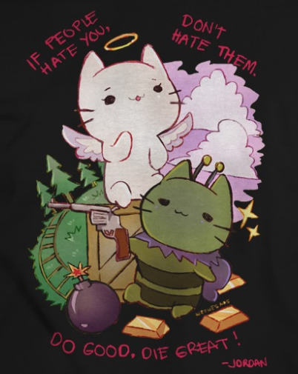
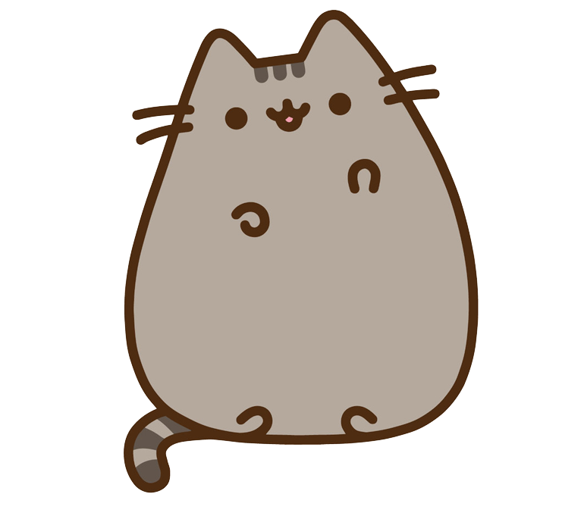


Artist Contributions Reference: Character
Jayden
Stylised cat with short limbs, easier to rig and animate + would fit in with a stylised environment.

Slide 9
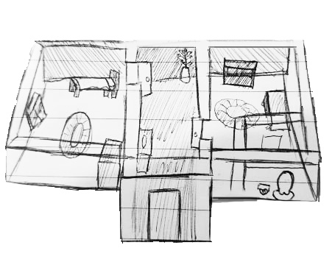
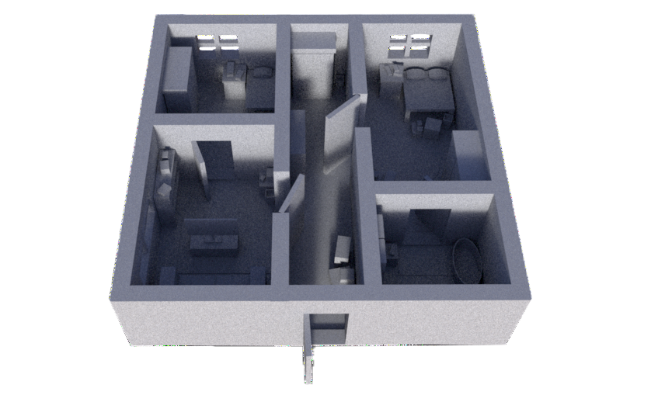
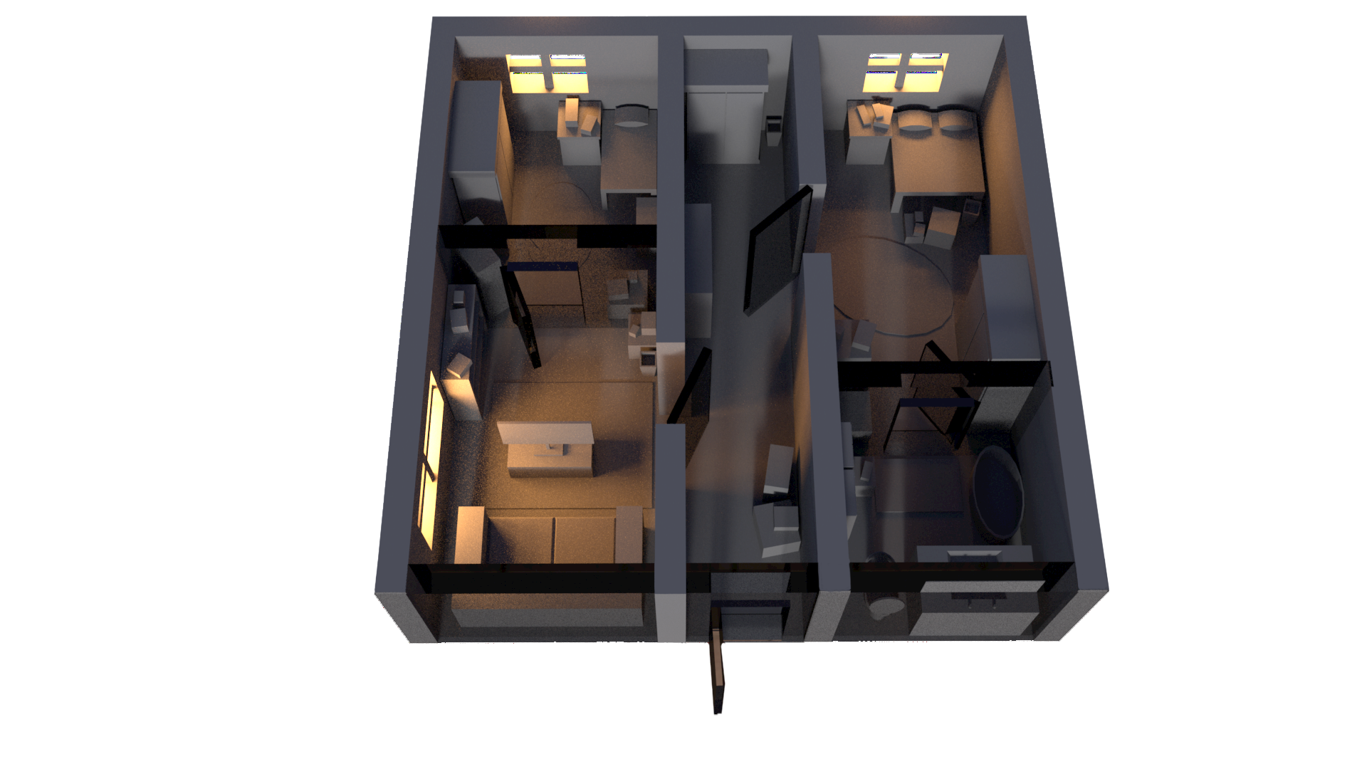
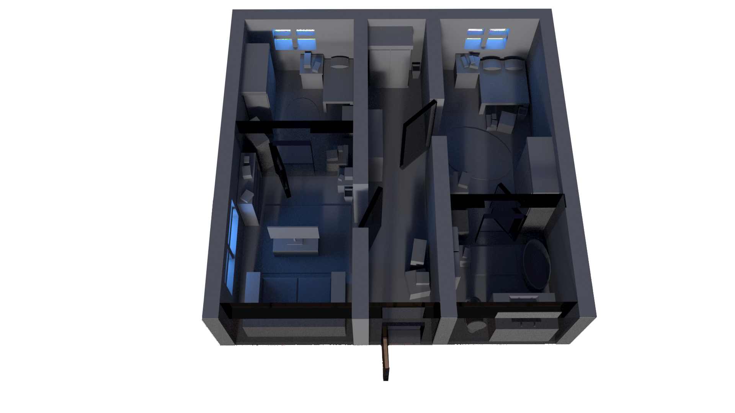
Artist Contributions Concept Images: Environment
Jayden
Sample map render, concept of how rooms would work together + camera angle.
Layout concept + top down angle test.
Transparent walls + the day night cycle mechanic showing. The transparent walls will be textured to have a gradient from opaque to transparent so the divide isn’t too harsh.
Night time lighting alternate.

Slide 10
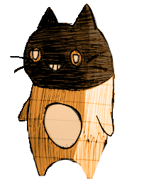
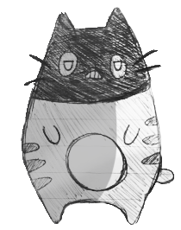
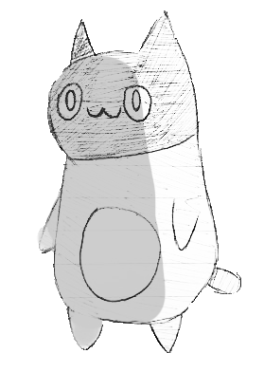
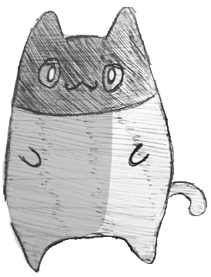
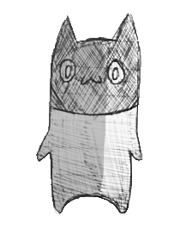
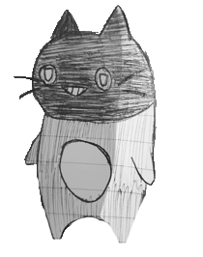
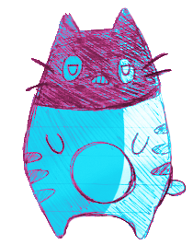
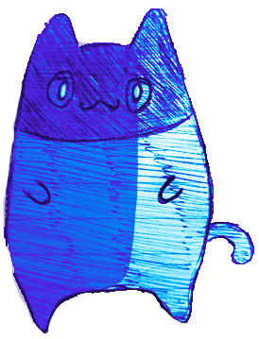
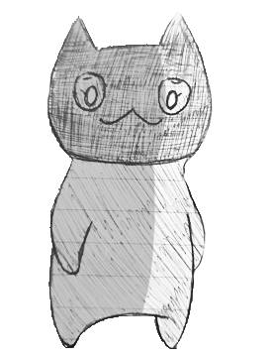
Artist Contributions Concept Images: Character
Jayden
Stylised cats wearing balaclavas.
Simple facial expressions + simple fur patterns. For co-op, change fur colours.
Colour tests, natural colour and unnatural colours.

Slide 11
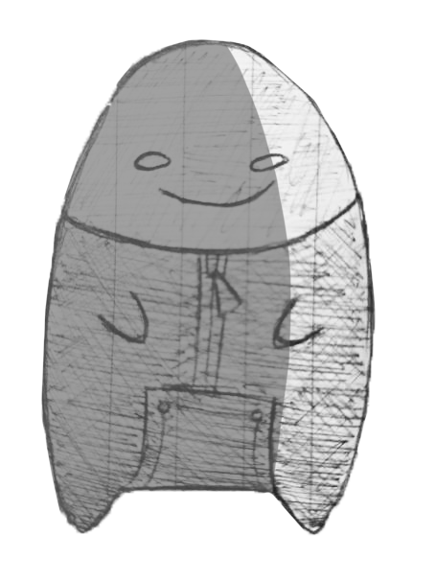
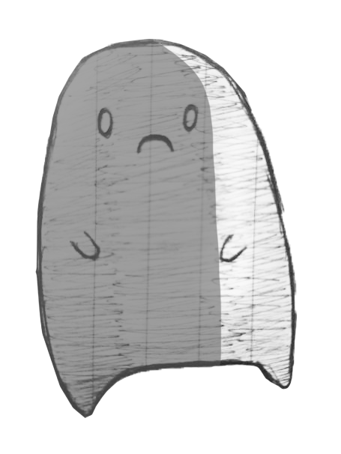
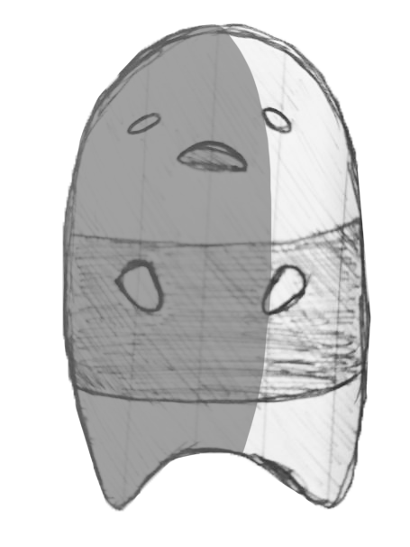
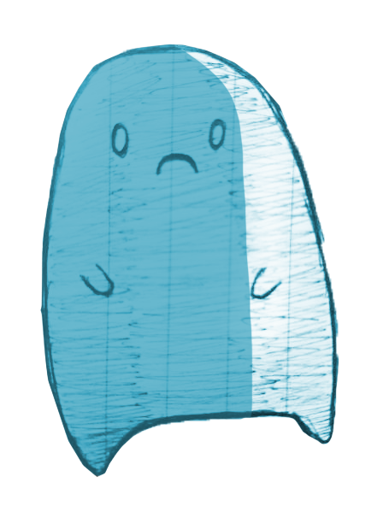
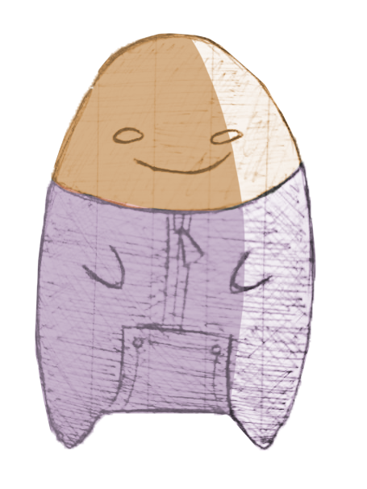
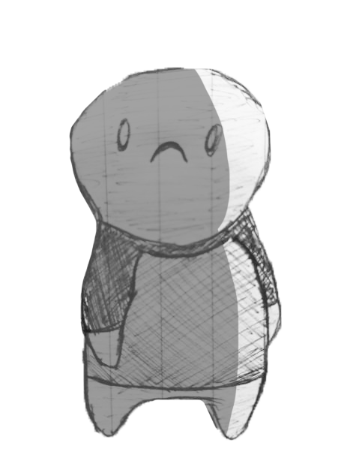
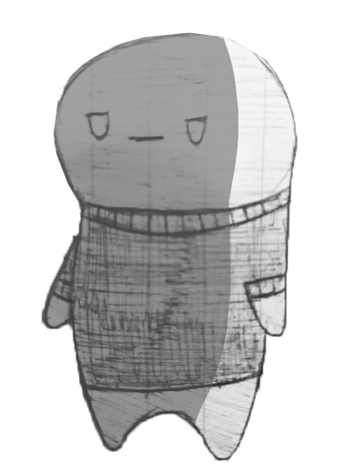
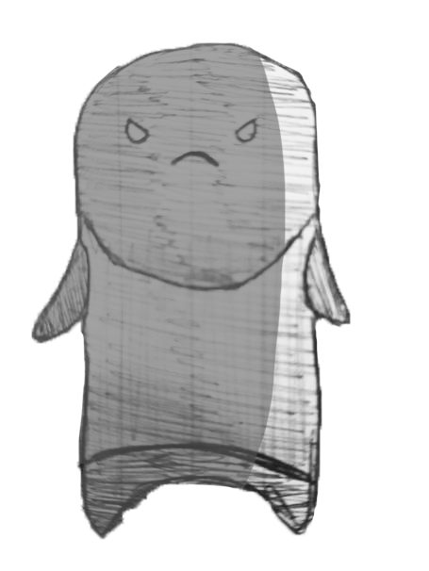
Artist Contributions Concept Images: Enemy
Jayden
Rip ears + tail off cat model so I won’t have to make a third rig.

Slide 12
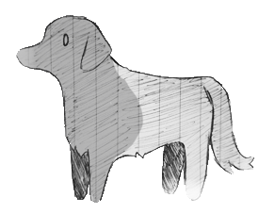
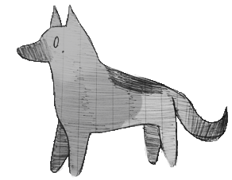
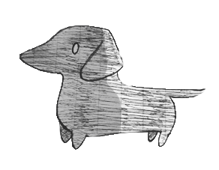
Artist Contributions Concept Images: Dog
Jayden
Simple model to match the cat model + simple environment. Easier to rig + animate.
Different dog silhouettes.
Sausage Dog
Golden Retriever
German Shepherd

Slide 13
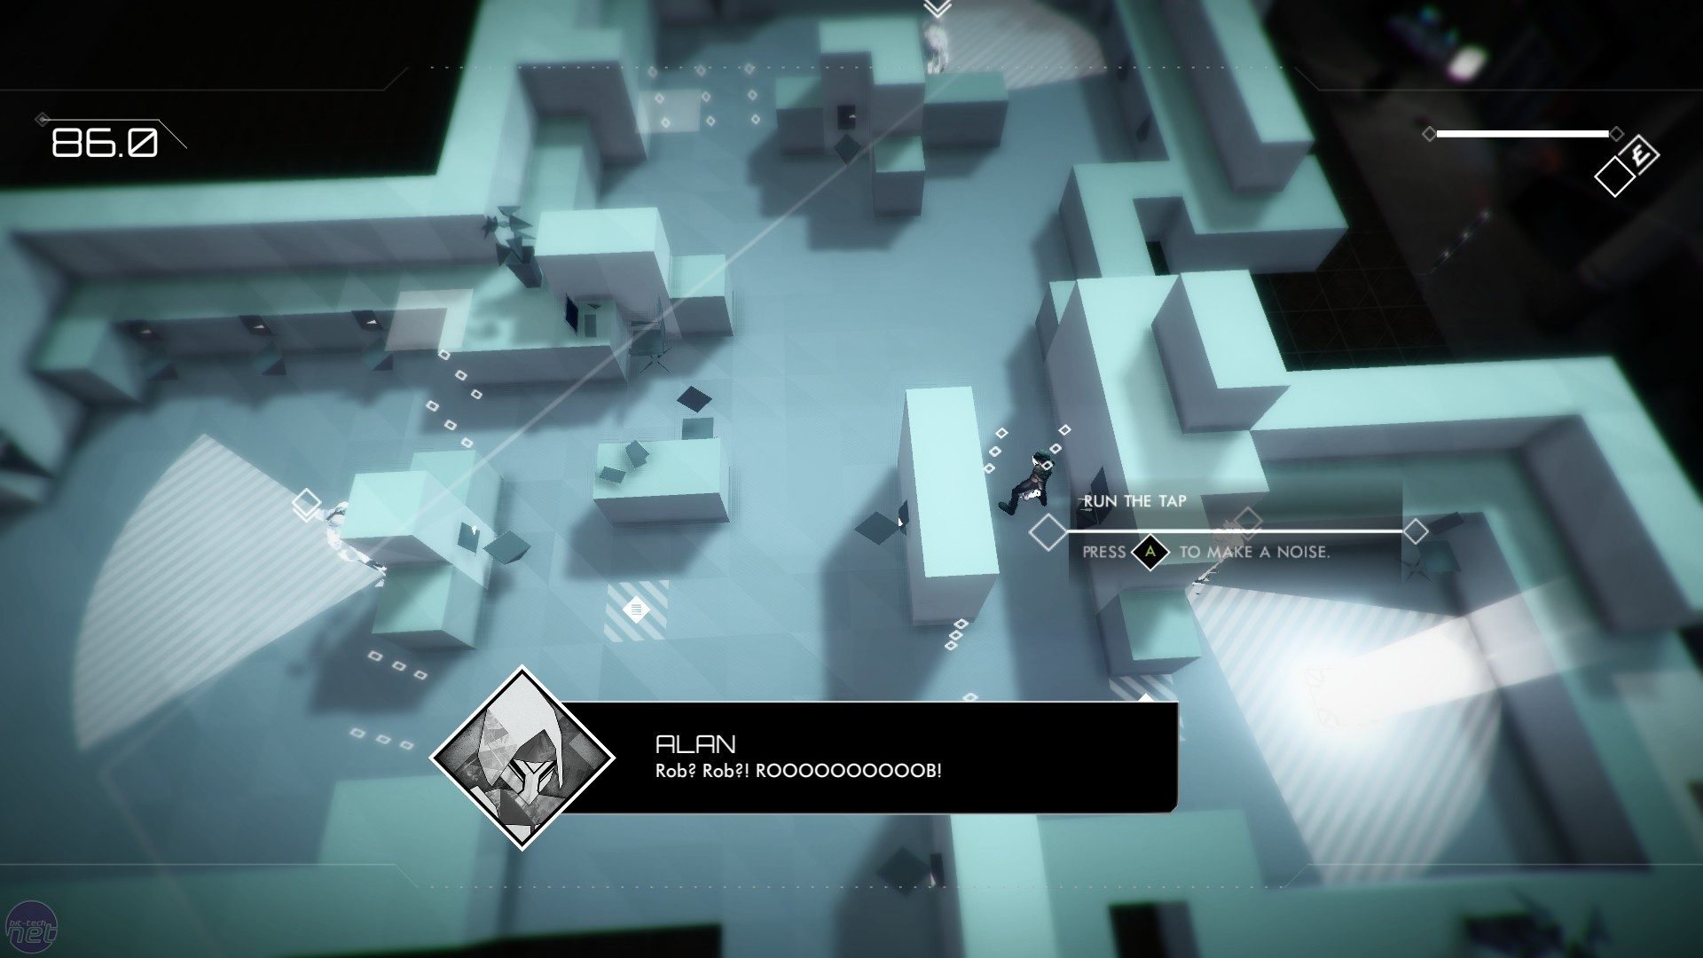
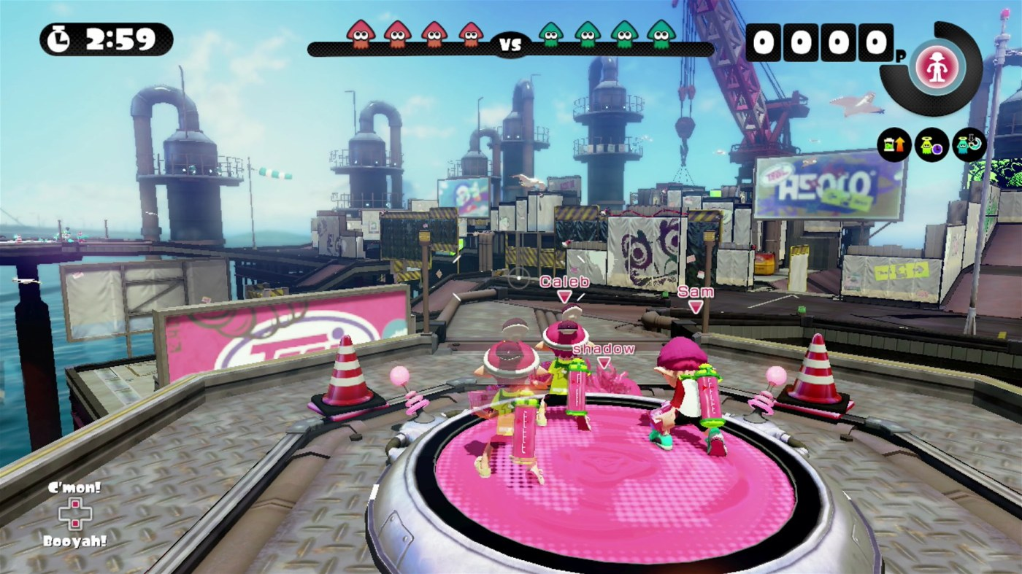
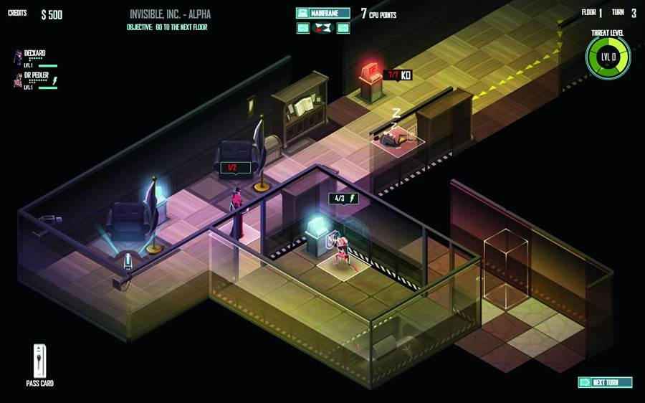
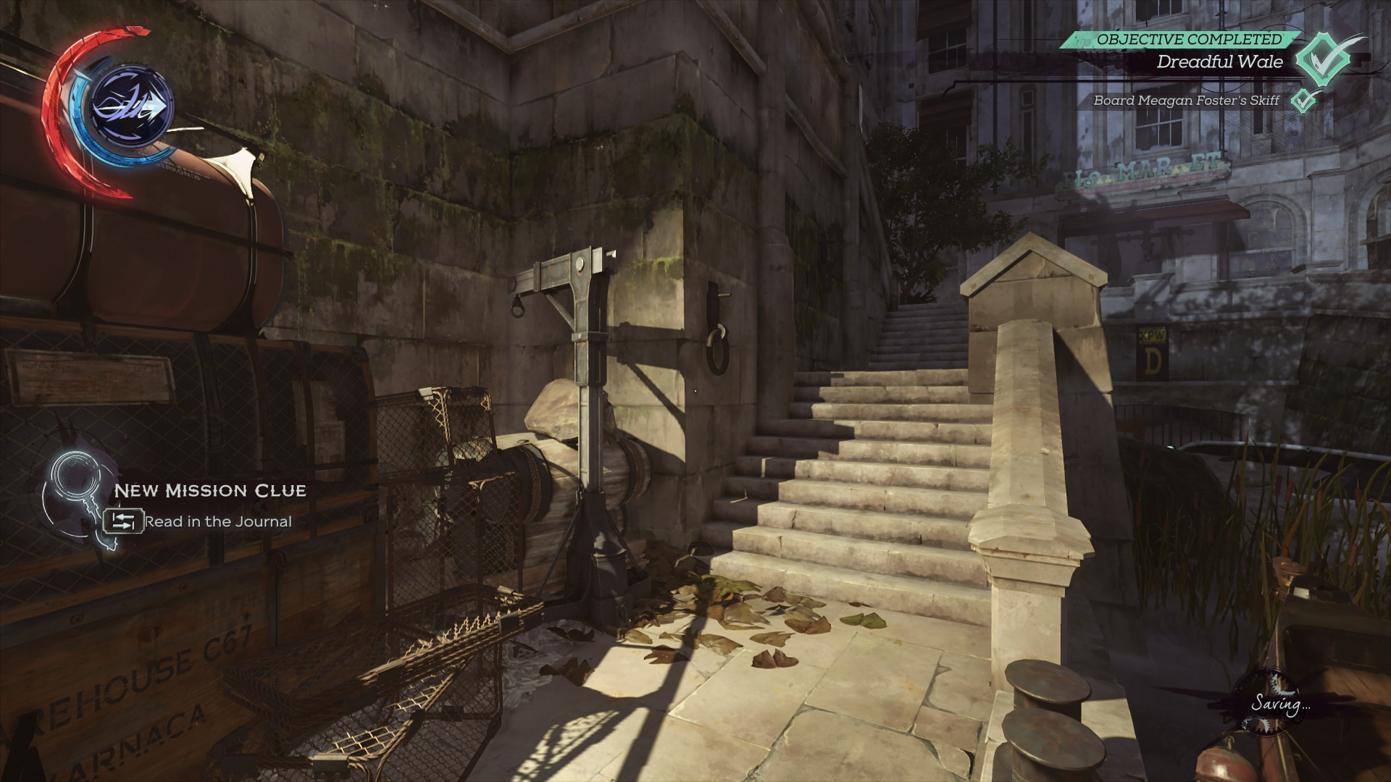
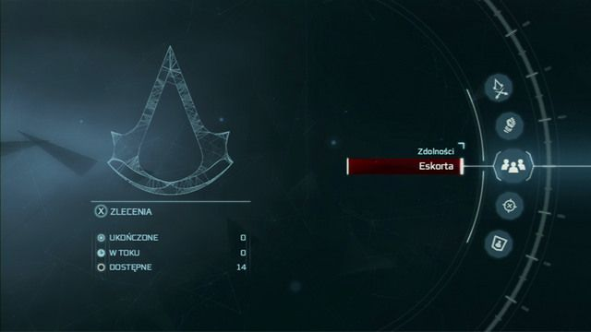
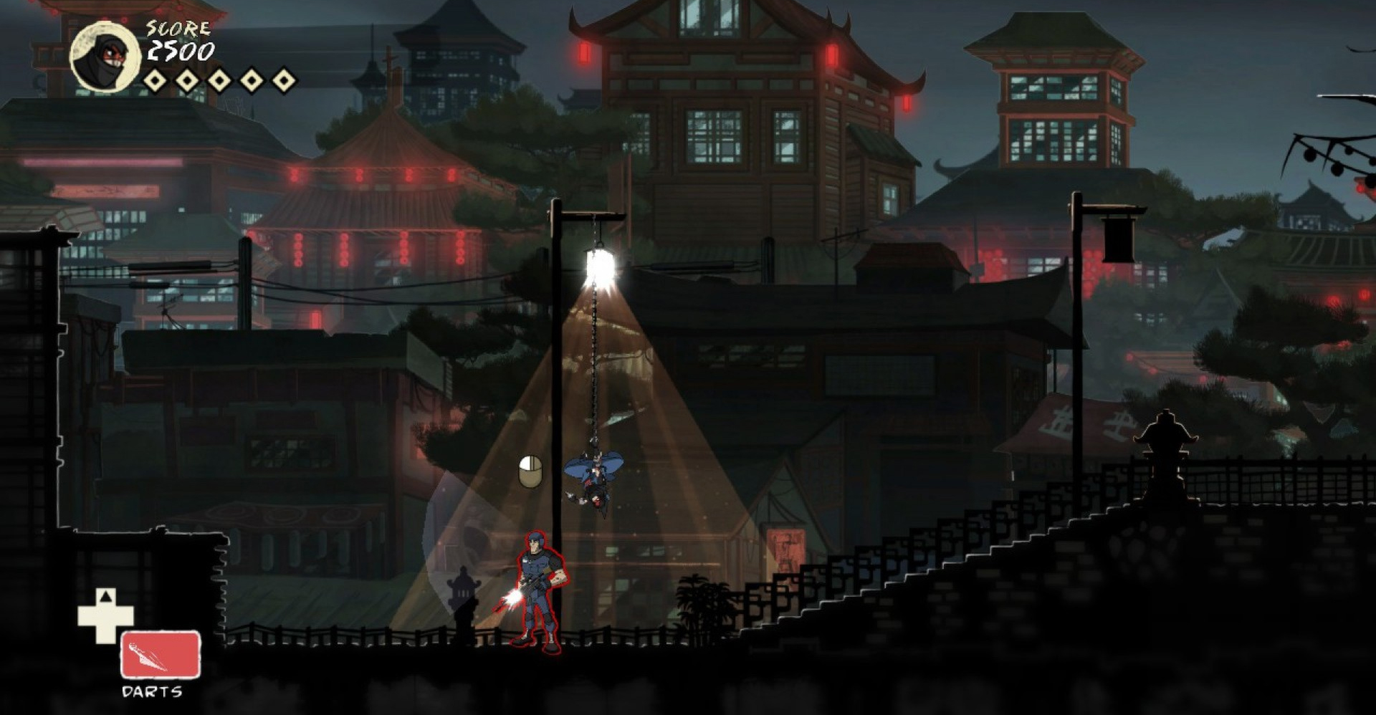
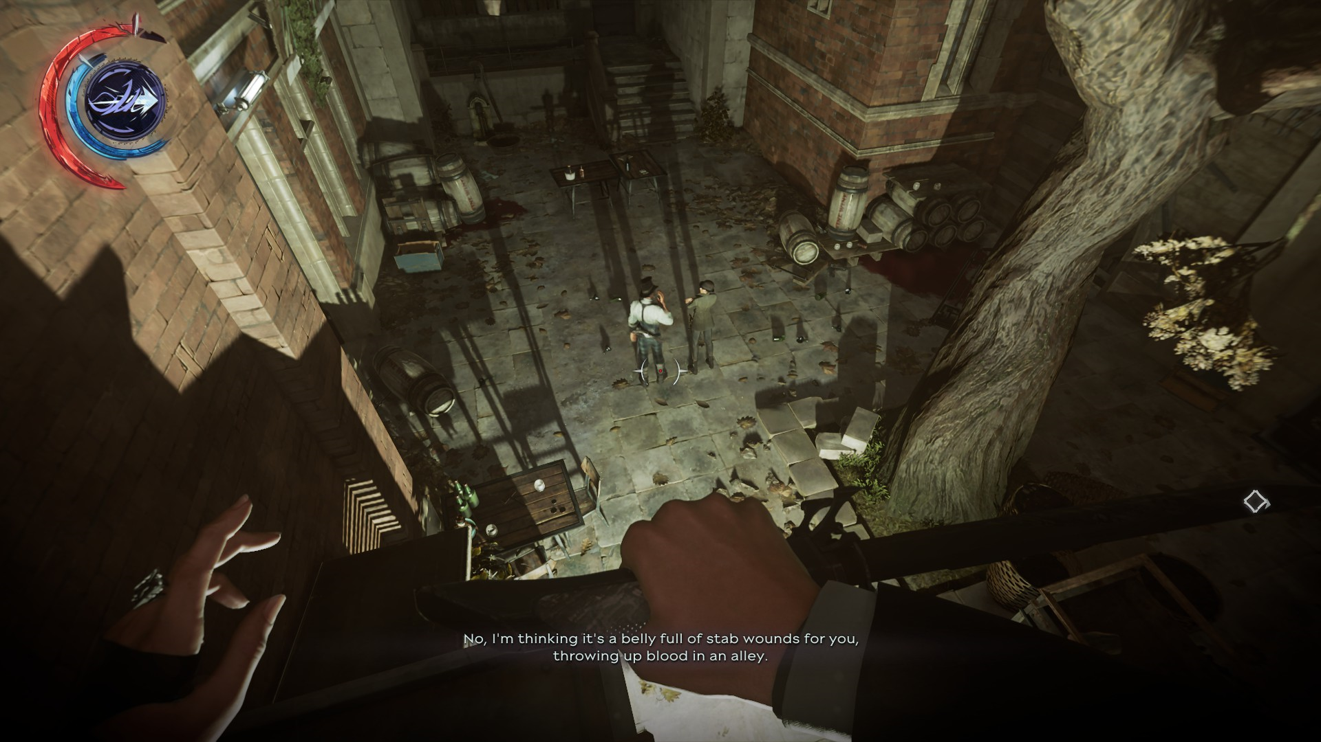
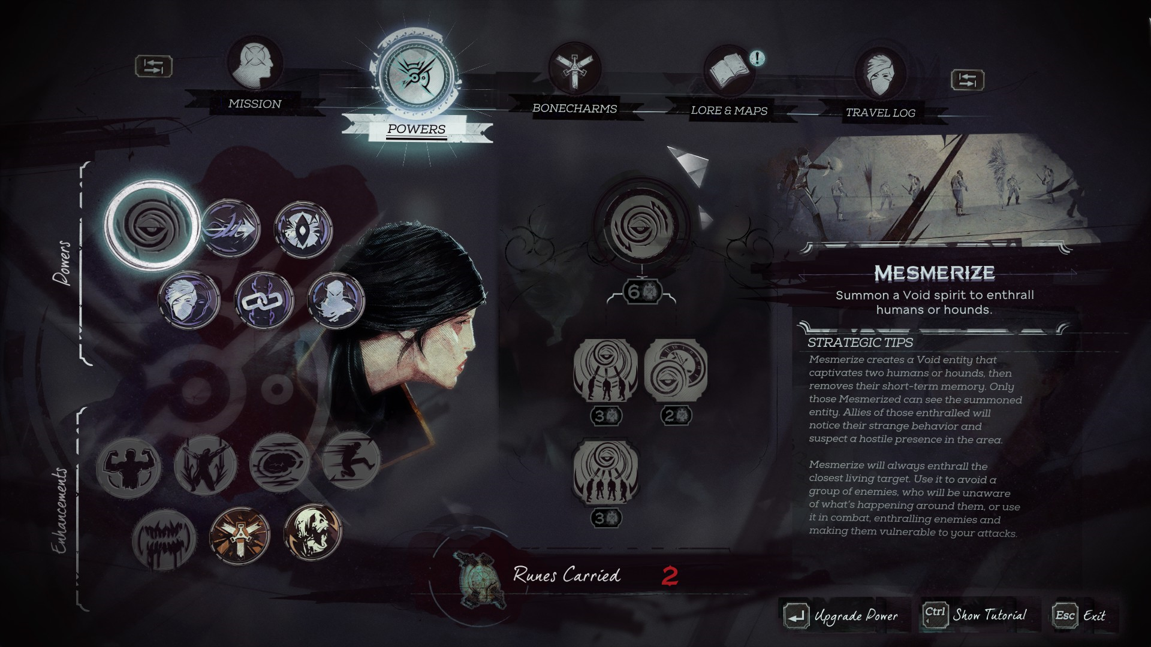
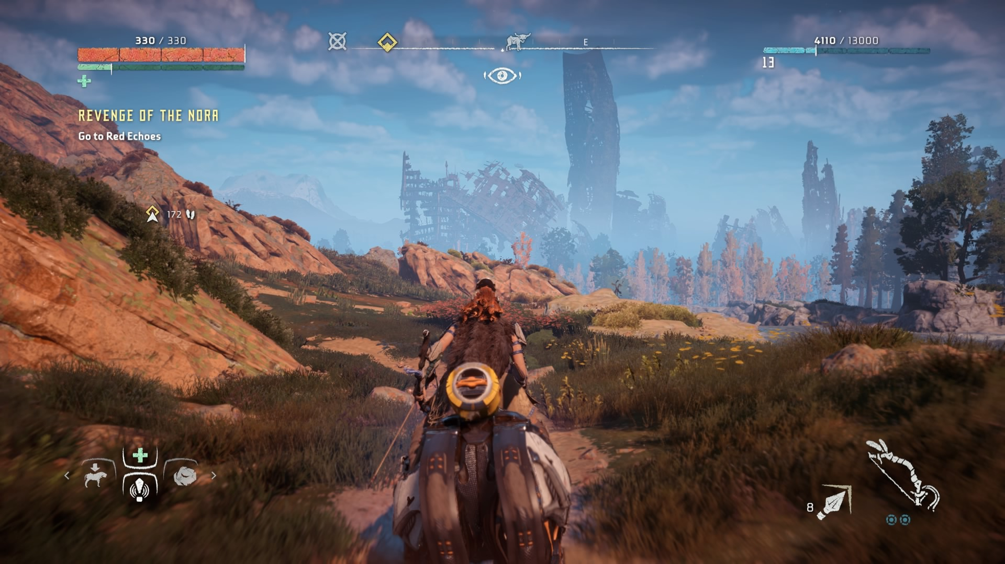
Artist Contributions Reference: User Interface
Jayden

Slide 14

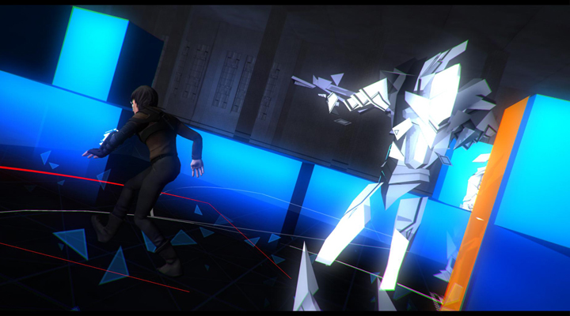


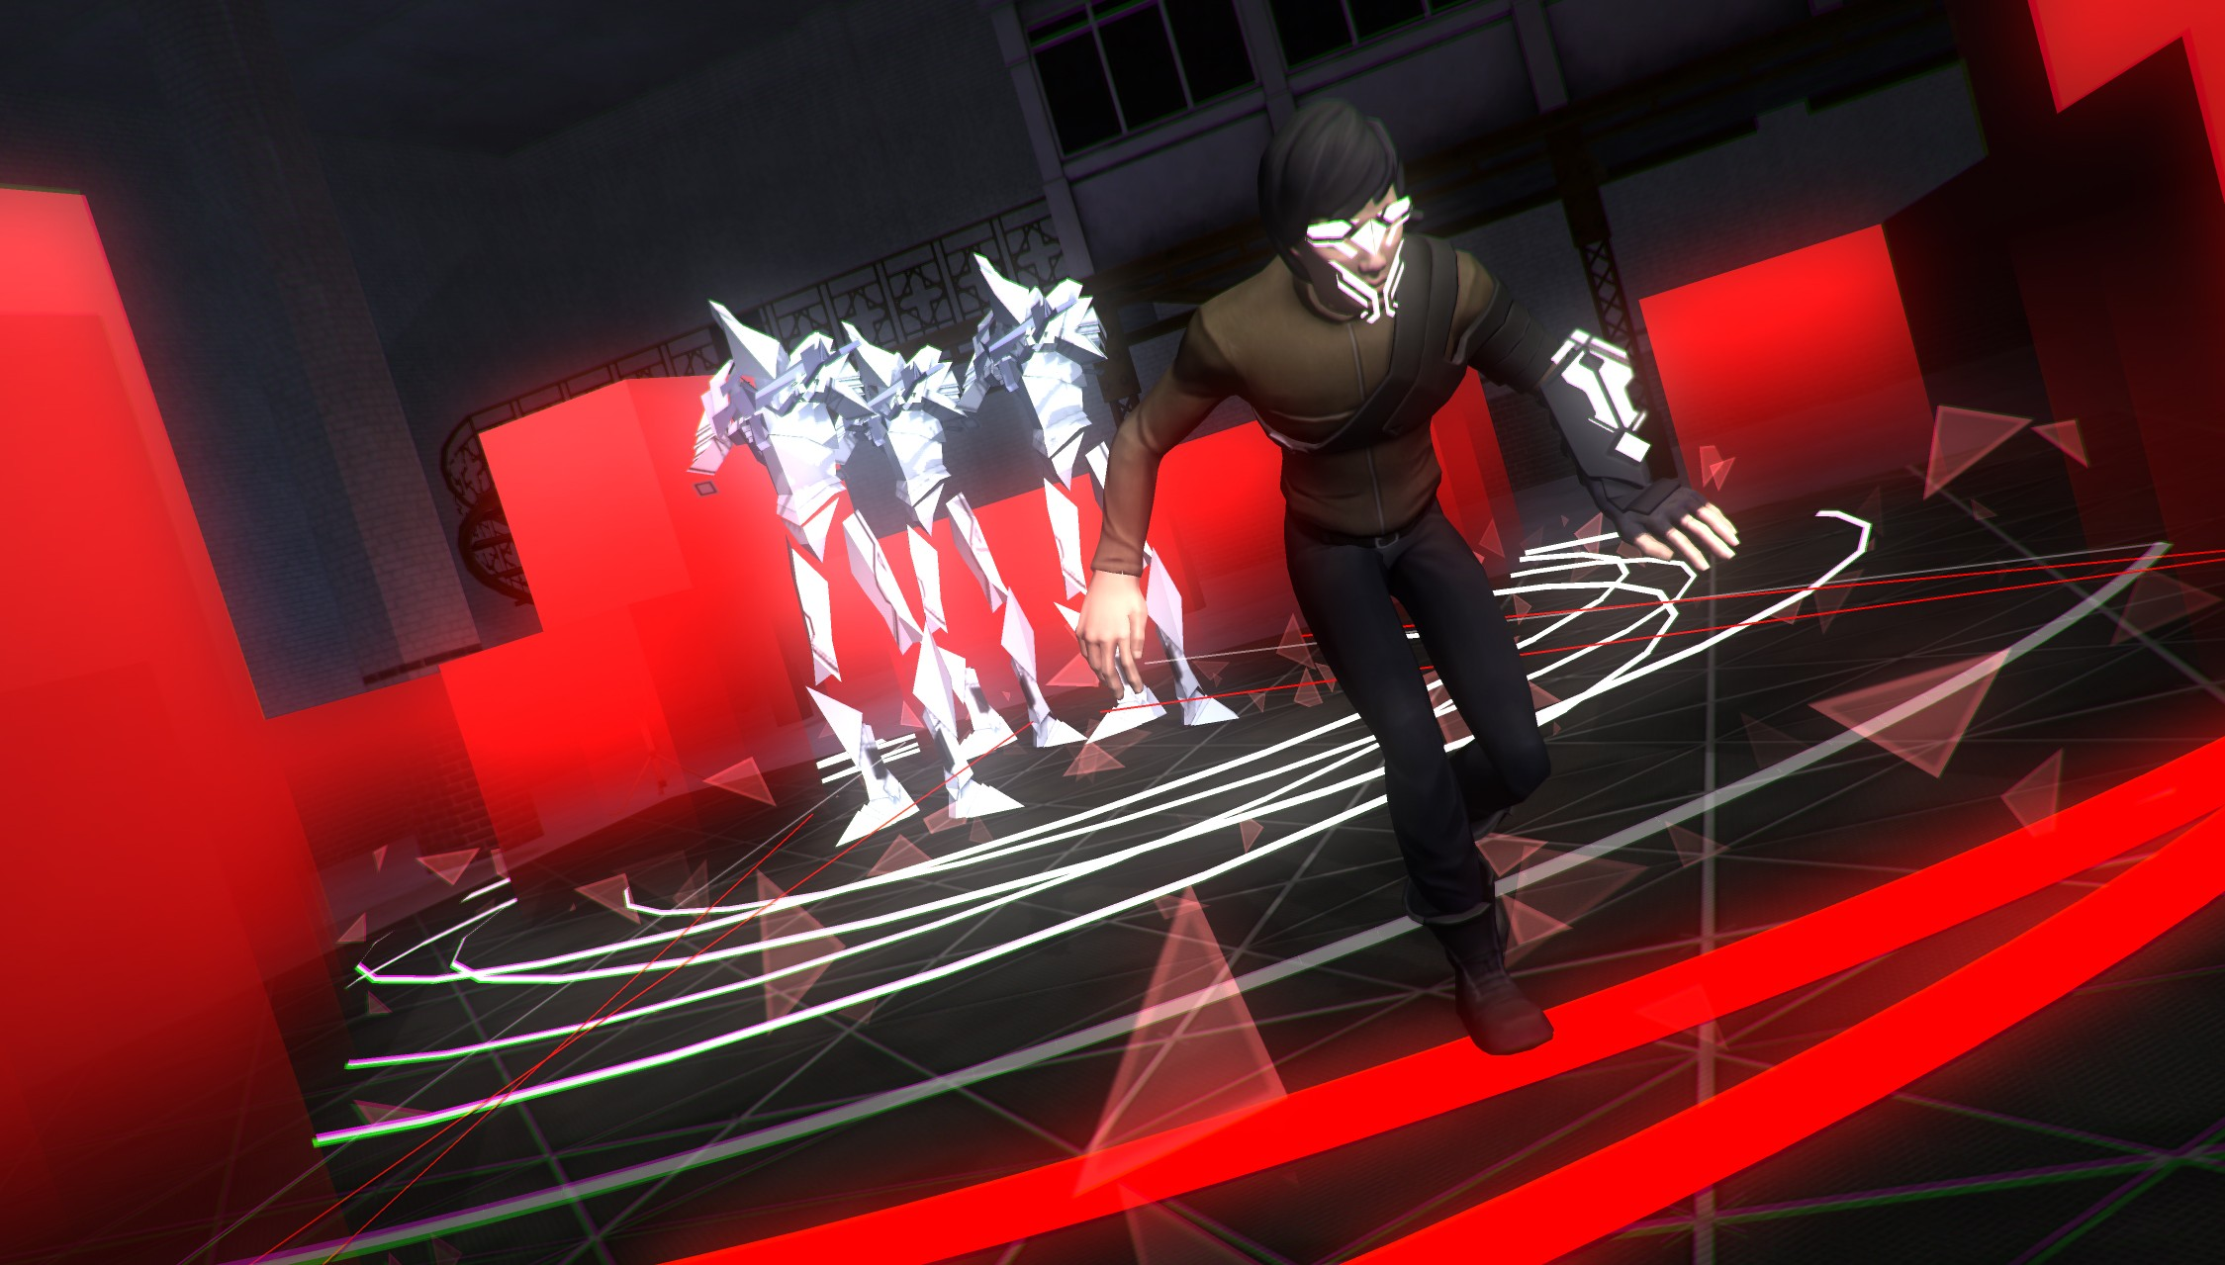
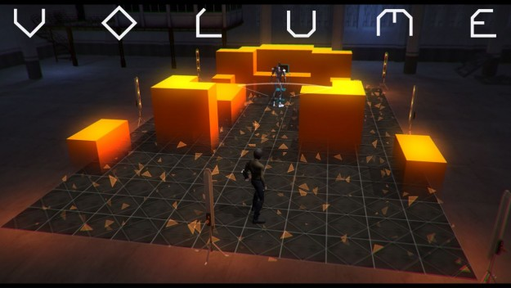
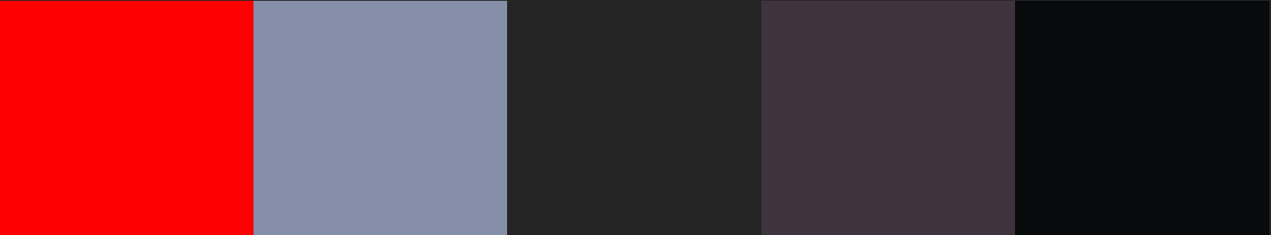

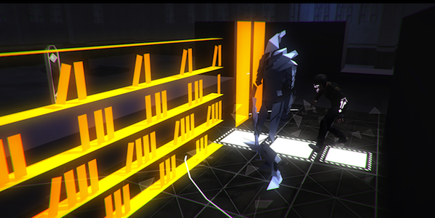
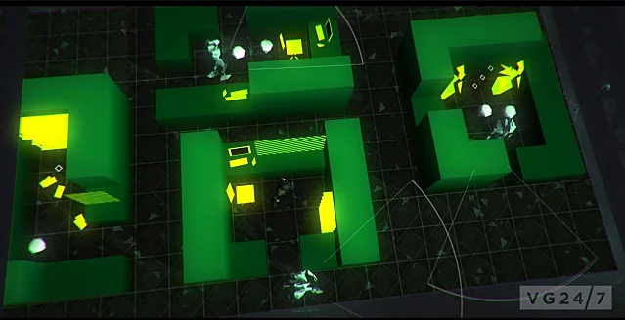




Artist Contributions Colour Palette Study
Jayden
Invisible Inc and Volume have similar colour palettes in the sense that they have bright/neon colours that contrast with a darker floor/outer walls. This colour palette is appealing and practical, as the brighter colours draw the attention of the player to important objects/ obstacles.

Slide 15






Artist Contributions Colour Palette Study
Jayden
Warp has a slightly desaturated colour palette, which makes everything look dark and grungy because it’s going to be dark.

Slide 16



Artist Contributions Reference: Furniture
Liam
We aim to create various preset rooms as modular pieces, and lay them out in varying ways to create different levels
Similar style of simplistic and blocky furniture
Cartoonish low poly style furniture, to fit the lighthearted character thematic
Stylized graphics for larger the larger furniture pieces such as beds and wardrobes

Slide 17




Artist Contributions Reference: Items
Liam
Low poly style for all of the item assets, with little hand texturing as they are smaller pieces where the textures won’t be able to be shown off as much
Lots of simpler items cluttered around in the background to fill in space
Little to no rounded edges on items, most will be harder surface to give the blocky style

Slide 18



Artist Contributions Reference: Walls/Background
Liam
Background pieces such as photographs or artwork can be placed on the walls so it doesn’t feel empty
Different wallpapers used for different rooms
Different colors used for different levels
Varying thickness to the walls for different rooms

Slide 19

Artist Contributions Concept Images: Items
Liam
Simple blocky style items, with little to no rounded edges
Coffee Machine
Game Console
Toaster

Slide 20


Artist Contributions Concept Images: Items
Liam
Modular rooms that can be used to create the house layout
Bedroom
Kitchen

Slide 21



Artist Contributions Colour Palette Study
Liam
Lighter color palette for items that will get darker with lighting effects during the night

Slide 22

Moodboard
Transparent walls and stylised art + slightly shifted top down camera

Slide 23
Project Asset List
Modular Rooms:
Bedroom
Living Room
Kitchen
Hallway
Bathroom
Laundry
Office
Garage
Item Pickups:
Watch, diamond ring, smartphone, pearl necklace, television, game console, dvd player, coffee machine, hair dryer, toaster, blender, video game, vase
Characters:
x2 Cat burglars (literally cats)
Dog
Enemy (same rig as cat)
Other Items
Door, double + single beds, bedside drawer, wardrobe, cupboard, kitchen sink, table, chair, lounge, coffee table, bookshelf, lamp, bath, toilet, hand basin.

Slide 24
Project Asset List - Roles
 | Jayden | Liam
Player Character | M/U/R/A/T ✔ | -
Enemy Character | M/U/R/A/T ✔ | -
Dog | M/U/R/A/T ✔ | -
Items | - | M/U/T ✔
Walls | H | M/U/T
Furniture | H | M/U/T ✔
UI | ✔ | -
Key
M = Model
U = Unwrap
R = Rig
A = Animate
T = Texture
✔= Doing task
H = Helping out

Slide 25






Platform Considerations
We will be developing the game on PC using unity, so there isn’t too much of a limitation.
The assets won’t be poly count heavy at all.
The art pipeline:
Texture correction & editing + UI
Player characters
Retopo, rigging + animation
Texturing
Limitations
We have only used UE4 during the year, so we’ll have to learn how unity works.
Mesh creation and UVs
Engine
Greybox

Slide 26
Tool Inventory
Maya
Substance Painter
Zbrush
Maya will be primarily used to create assets for the game environment as well as retopologize and rig 3D character models (which will be made in Zbrush). Substance Painter will be used to texture all our assets and export each texture map for Unity.

Slide 27
Art Specifications -Naming Conventions
2D, 3D assets + materials
File Name | Art Type (Textures)
[***]_base | Base Colour
[***]_norm | Normal
[***]_met | Metallic
[***]_ao | Ambient Occlusion
[***]_emiss | Emissive
File Name | Art Type (3D)
[***]_char | Character Model
[***]_item | Items
[***]_wall | Walls
[***]_furniture | Furniture
Key
[***] = asset name

